Slide 1

JAIN COLLEGE OF ENGINEERING AND RESEARCH
Department of Computer Science and Engineering Belagavi
Academic Year 2024-2025
Personal Progress Tracker
Presented By:
1. Satyam Gurav
2. Smita Kalsekar
3. Priyanka Kugaji
4. Pranjal Patil

Slide 2
Introduction:
The Personal Progress Tracker (PPT) is a comprehensive desktop application designed to help individuals to monitor and enhance their personal and academic development.
By providing a comprehensive platform for tracking progress, setting goals, and receiving feedback, the Personal Progress Tracker aims to boost motivation, engagement, and overall success.
Problem Statement:
In today’s fast-paced world, people often struggle to maintain consistent progress in both personal and academic tasks, due to a lack of a structured tools to monitor daily progress setting goals, and receiving feedback, which can lead to decreased motivation and inefficient performance.
Without a structured system to monitor achievements and areas for improvement, it becomes difficult to set realistic goals and measure success. Additionally, without proper tracking, it becomes difficult to analyze the success of efforts and identify areas for improvement .

Slide 3
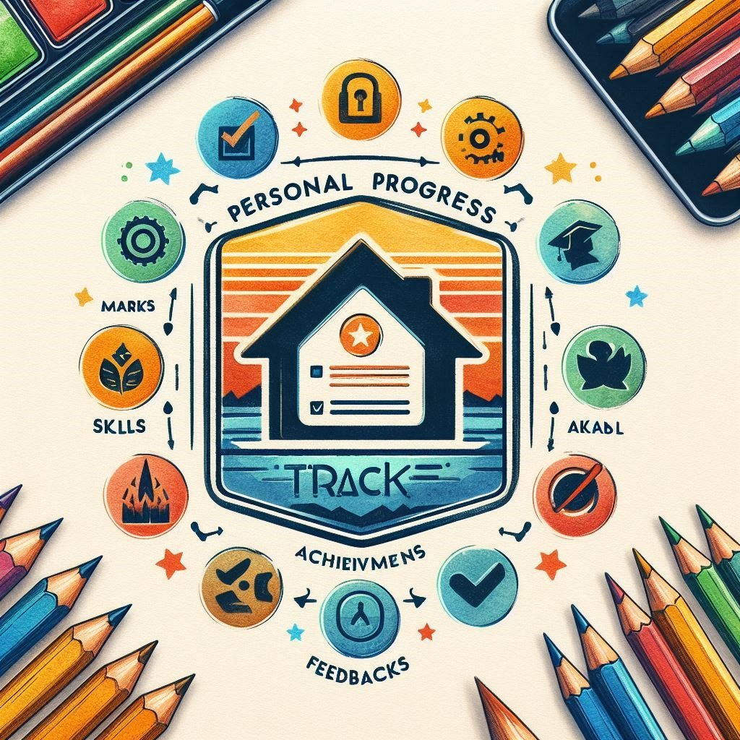
Objectives:
A Holistic Approach to Growth
The project provides a comprehensive platform where users can track multiple aspects of their progress in one place.
It includes modules for tracking marks, skills, achievements, feedback, graphs, and certificates.
This holistic approach helps individuals stay organized and focused on different areas of self-improvement.
1
Track Academic Progress
2
Enhance Mentor Guidance
Develop a structured,user-friendly application for students to track their marks, skills, achievements, and receive feedback.
Improve the effectiveness of mentor feedback by providing a platform for organized communication and documentation.
3
Boost Academic Performance
Analyze data to help users to stay organized,motivated,and productive.
Iddentify and address areas where improvement is needed.
Increase student engagement and motivation, ultimately leading to improved academic performance and retention.

Slide 4
Literature Survey:
Personal Progress Tracking System Relevant Research:
Zimmerman (2002): The study explores self-regulated learning, focusing on how individuals can manage their goals and motivation through progress tracking and reflection.
Baker et al. (2010): This research emphasizes the role of goal-setting and self-monitoring in personal success. The PPT application in the code allows users to add marks, skills, and feedback, which are essential components of this self-regulation process.
2.Motivation in Personal Progress Tracking
Relevant Research: Hamari et al. (2014): This review discusses the effectiveness of gamification elements in digital applications, showing that the use of rewards, progress tracking, and visual feedback enhances user motivation.
3.Data Visualization and Graphs in Personal Progress Tracking
Fogg et al. (2009): The authors highlight how visual feedback, such as graphs and progress bars, can enhance user engagement by making progress more tangible and easier to track.
4.Use of PDF and Export Functionality
Relevant Research: Zhou & Lee (2016): This research shows the role of digital portfolios (such as PDFs) in education and career development. The ability to share and record progress fosters accountability and provides a sense of accomplishmentdata for personal development.

Slide 5
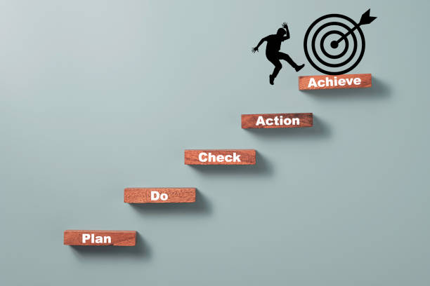
Planning Phase
1
Define project scope, objectives, and target audience. Conduct feasibility studies to assess technical, operational, and economic viability.
2
Analysis Phase
Develop a detailed Software Requirements Specification (SRS) document, outlining functional and non-functional requirements.
Design Phase
3
Create high-level and low-level designs, including user interface designs, to guide the implementation process.
4
Implementation Phase
Develop the application using Python, CustomTkinter, and PIL, ensuring modularity and efficient code structure.
Testing Phase
5
Conduct thorough testing at unit, integration, and system levels to ensure quality and functionality. Perform user acceptance testing (UAT) to ensure usability.
6
Deployment Phase
Package the application for distribution and deployment. Provide user manuals and support to ensure successful adoption.
Maintenance Phase
7
Continuously monitor the application's performance, address bug reports, and implement enhancements to keep the software relevant and effective.

Slide 6
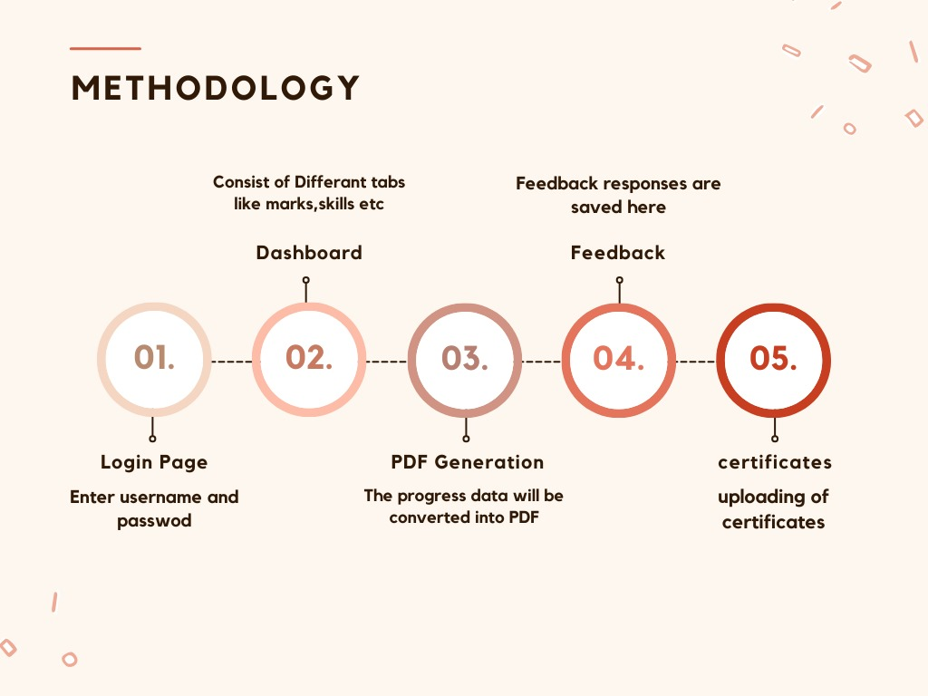

Slide 7
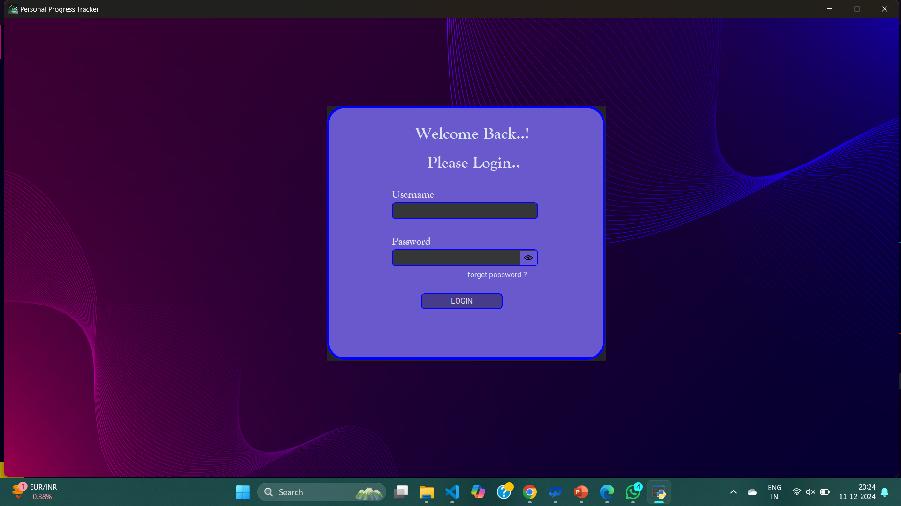
Implementation:

Slide 8
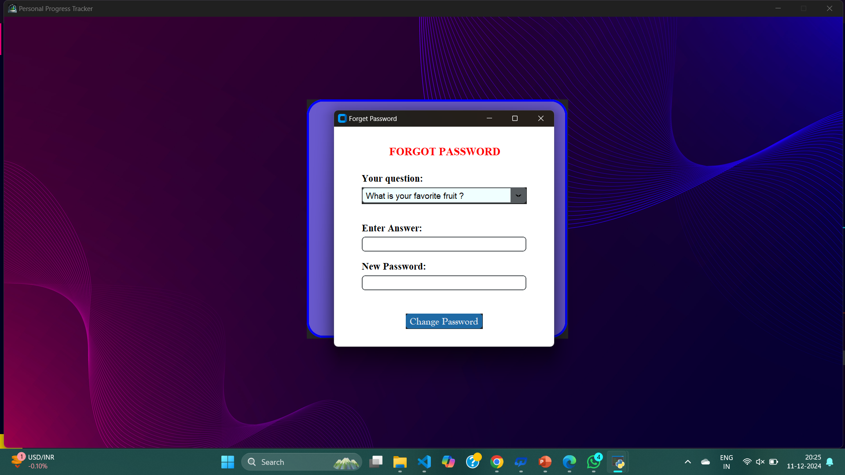

Slide 9
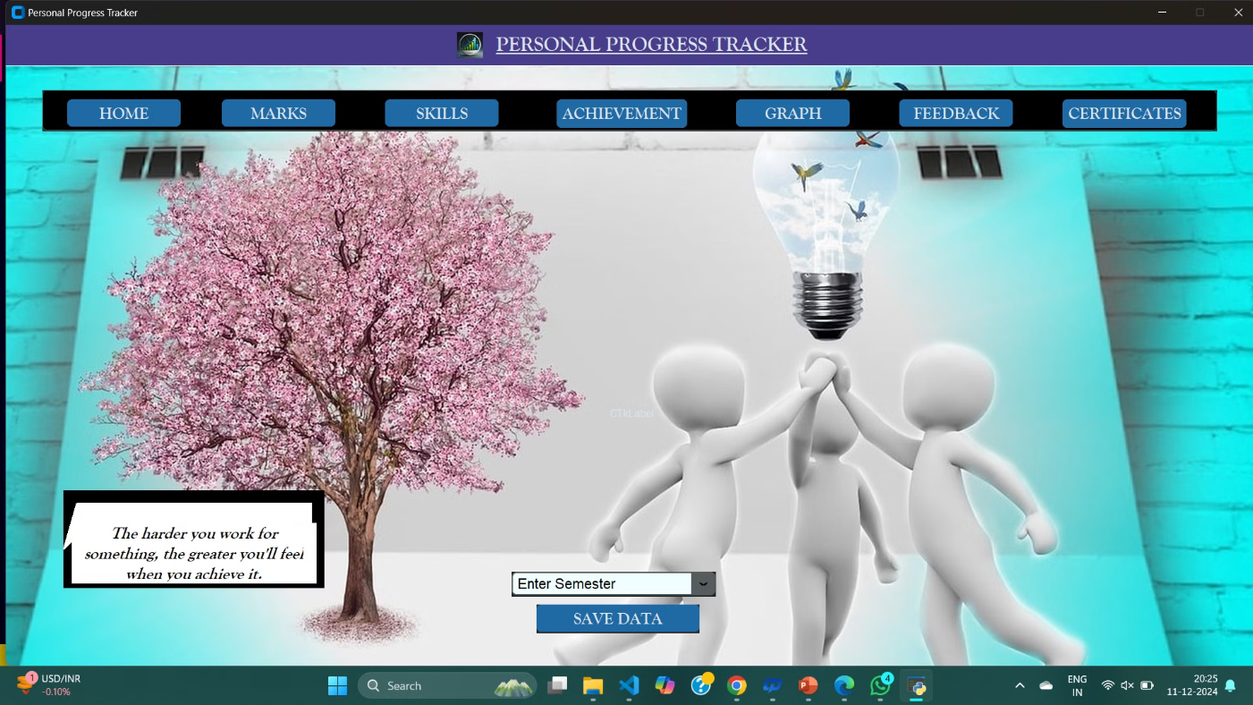

Slide 10
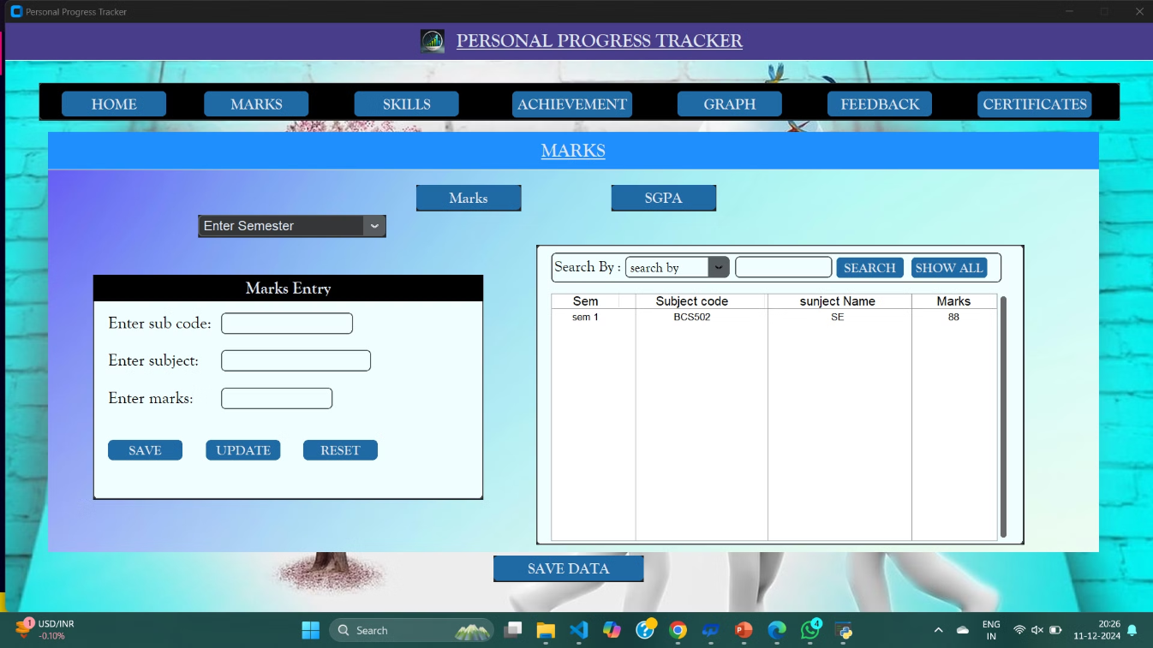

Slide 11
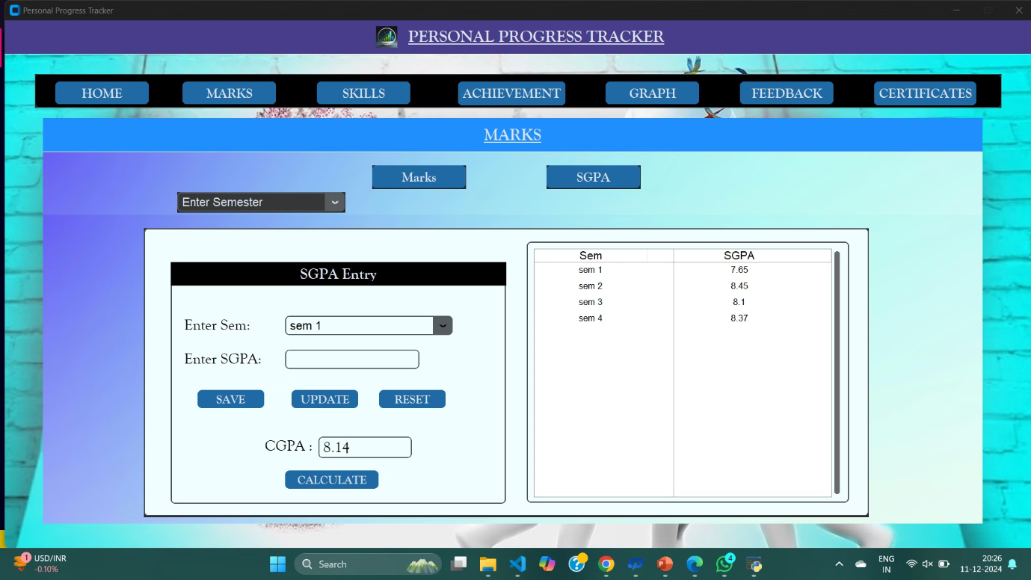

Slide 12
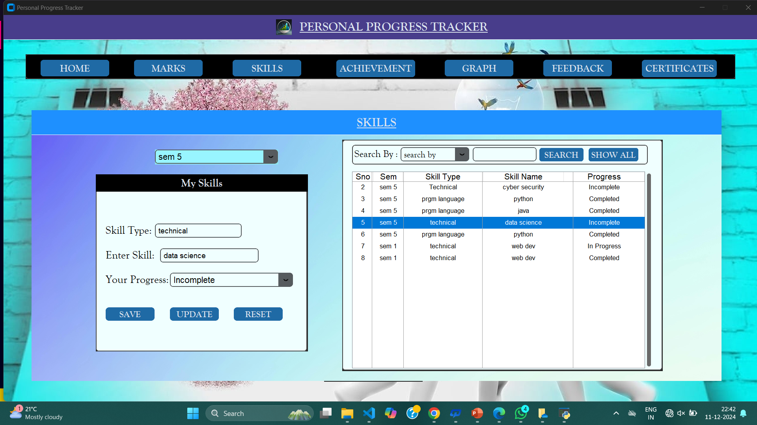

Slide 13
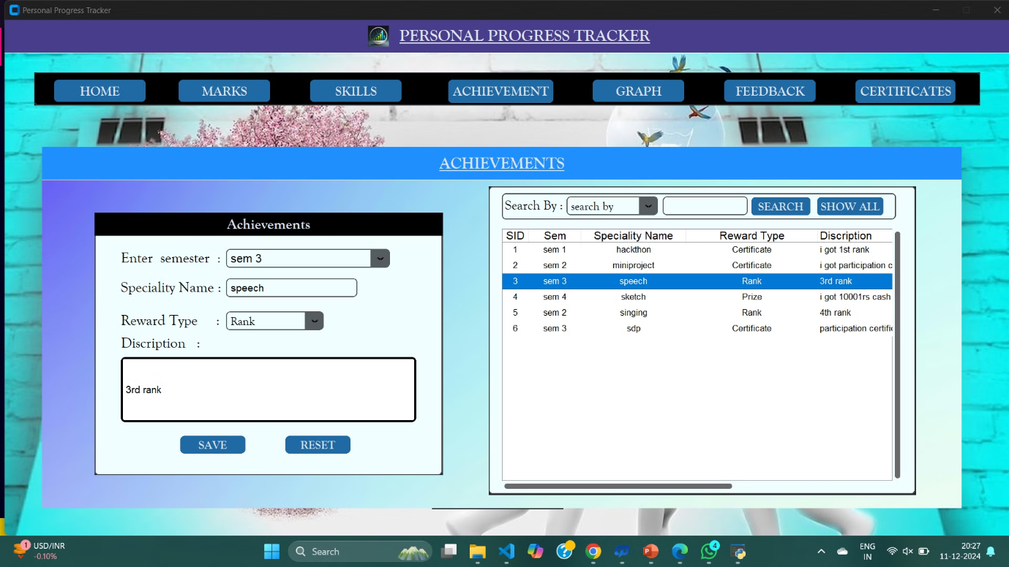

Slide 14
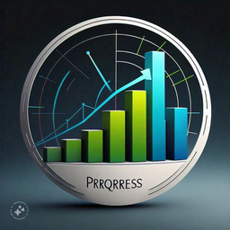
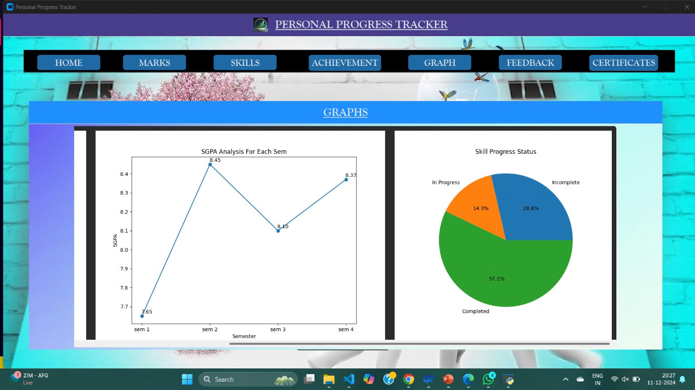

Slide 15
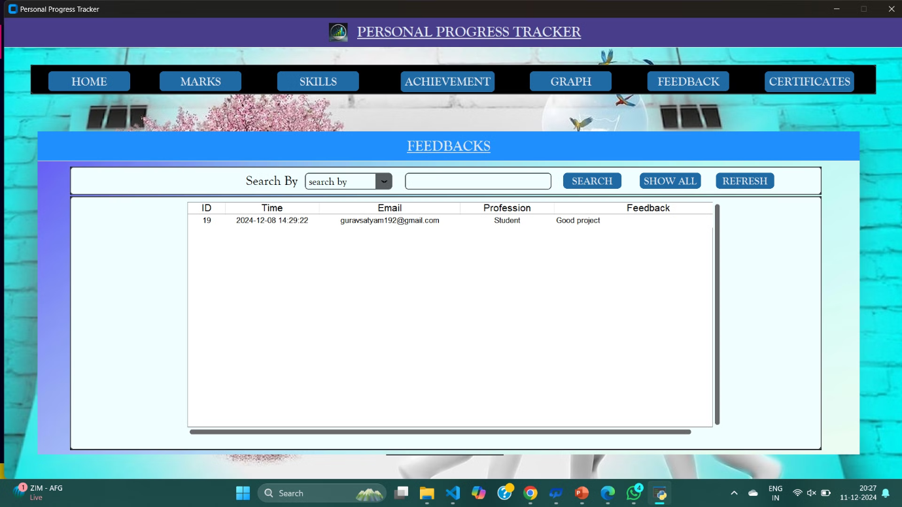

Slide 16
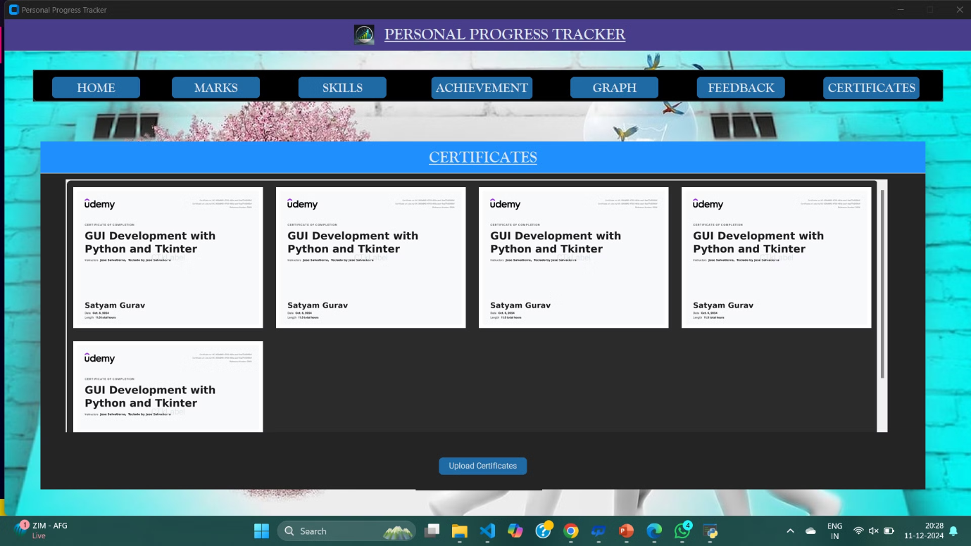

Slide 17

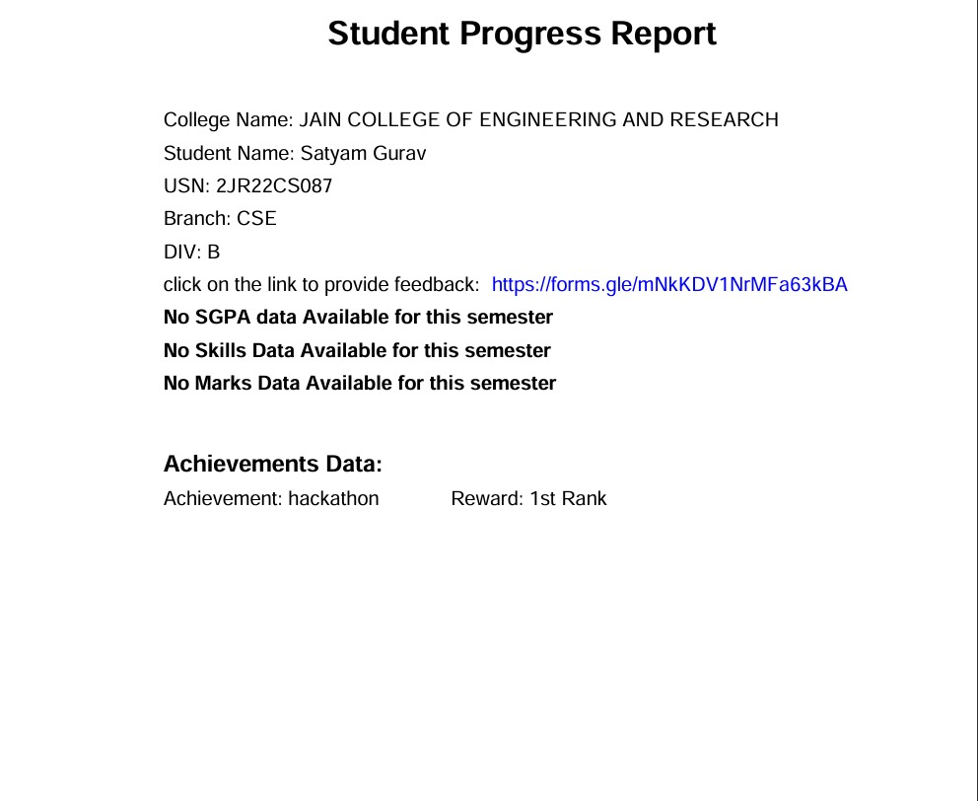

Slide 18
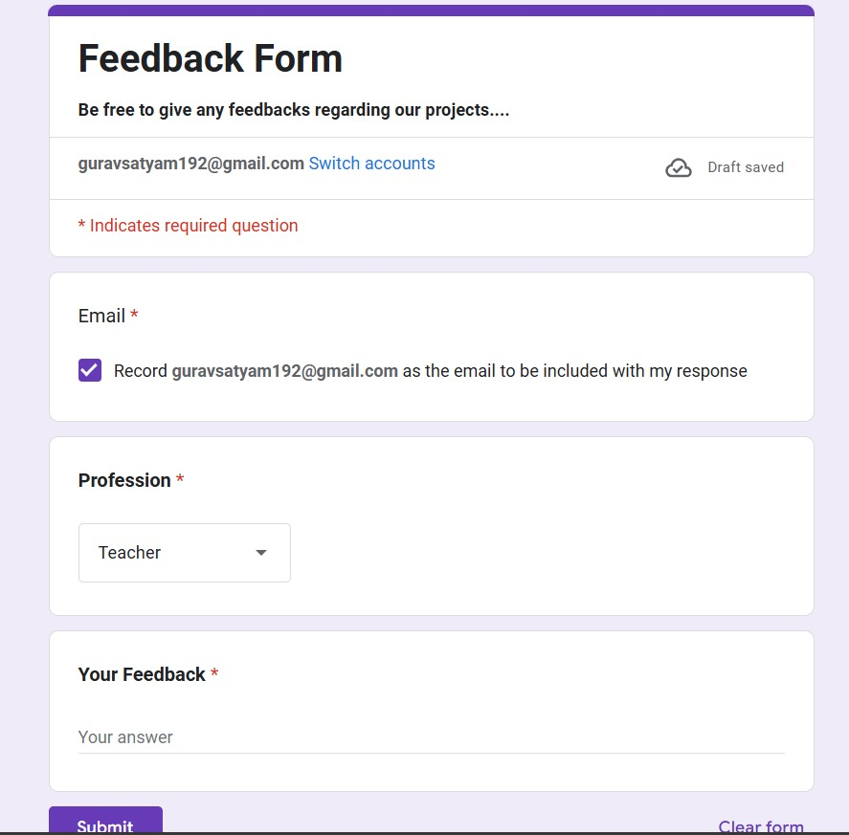

Slide 19

Conclusion:
In conclusion, this Personal Progress Tracker serves as a valuable tool for anyone aiming to stay on top of their goals, enhance their productivity, and visualize their personal and academic growth.
Facilitating the sharing and celebration of ​ acchivements​.

Slide 20
References:
1. Graphical User Interfaces (GUIs) in Python:
Reference: Buchanan, R.(2001). Designing for user experience. ACM Transactions on Computer-Human Interaction(TOCHI), 8(2), 155-179.
2. Use of Motivational Quotes in Application Design:
Reference: a: Deterding, S., Dixon, D., Khaled, R., & Nacke, L. (2011). From game design elements to gamefulness: defining" gamification". Proceedings of the 2011 annual conference on Human Factors in Computing Systems. ACM. b: Cheung, M. F. Y., & Chan, K. K. L. (2016).
3.The role of motivational feedback in the design of health apps:
Enhancing user engagement and health outcomes. Health Informatics Journal, 22(4), 1089-1099.
4. Modular Windows and Multi-window Design:
Reference: McMillan, D., & Hwang, J. (2003).User-centered design in software engineering: A review of user interface architecture. Journal of Software Engineering Practice, 13(4), 273-292.
5.Event-driven Programming and GUI Interaction:
Reference: Zhang, X., & Yu, W. (2005). Event-driven programming with GUI-based applications: A study of user interactions. Journal of Interactive Software Engineering, 22(1), 45-53.
6. Personalized Progress Tracking Systems:
Reference: Liu, D., & Zhou, W. (2021). A personalized progress tracking system in online learning environments: Design and evaluation. International Journal of Educational Technology, 17(3), 213-230.

Slide 21



